Slide 1
Queue ADT

Slide 2
Queues
Definition of a Queue
Examples of Queues
Design of a Queue Class
Diﬀerent Implementations of the Queue Class

Slide 3
Introduction to Queues
A queue is a waiting line
It’s in daily life:
A line of persons waiting to check out at a supermarket
A line of persons waiting to purchase a ticket for a film
A line of planes waiting to take off at an airport
A line of vehicles at a toll booth

Slide 4
Deﬁnition of a Queue
A queue is a data structure that models/enforces the ﬁrst-­‐come ﬁrst-­‐serve order, or equivalently the ﬁrst-­‐ in ﬁrst-­‐out (FIFO) order.
That is, the element that is inserted first into the queue will be the element that will deleted first, and the element that is inserted last is deleted last.
A waiting line is a good real-­‐life example of a queue. (In fact, the British word for “line” is “queue”.)

Slide 5
Queues
Unlike stacks in which elements are popped and pushed only at the ends of the list
Collection of data elements:
items are removed from a queue at one end, called the FRONT of the queue;
and elements are added at the other end, called the BACK

Slide 6
Introduction to Queues
Difference between Stack and Queues:
Stack exhibits last-in-first-out (LIFO)
Queue exhibits first-in-first-out (FIFO)

Slide 7
The Queue Operations
A queue is like a line of people waiting for a bank teller. The queue has a front and a rear.
$ $
Front
Rear

Slide 8
The Queue Operations
New people must enter the queue at the rear. This is called an enqueue operation.
$ $
Front
Rear

Slide 9
The Queue Operations
When an item is taken from the queue, it always comes from the front. This is called a dequeue operation.
$ $
Front
Rear

Slide 10
Queue Abstract Data Type
Basic operations
Construct a queue
Check if empty
Enqueue (add element to back)
Front (retrieve value of element from front)
Dequeue (remove element from front)

Slide 11
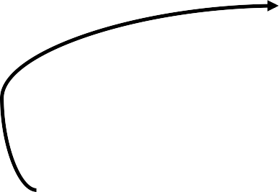
A Graphic Model of a Queue
Head: All items are deleted from this end
Tail:
All new items
are added on this end

Slide 12
Operations on Queues
Insert(item): (also called enqueue)
It adds a new item to the tail of the queue
Remove( ): (also called delete or dequeue)
It deletes the head item of the queue, and returns to the caller. If the queue is already empty, this operation returns NULL
getHead( ):
Returns the value in the head element of the queue
getTail( ):
Returns the value in the tail element of the queue
isEmpty( )
Returns true if the queue has no items
size( )
Returns the number of items in the queue

Slide 13
Queue as a Class
Much like stacks and linked lists were designed and implemented as classes, a queue can be conveniently packaged as a class
It seems natural to think of a queue as similar to a linked list, but with more basic operations, to enforce the FIFO order of insertion and deletion

Slide 14

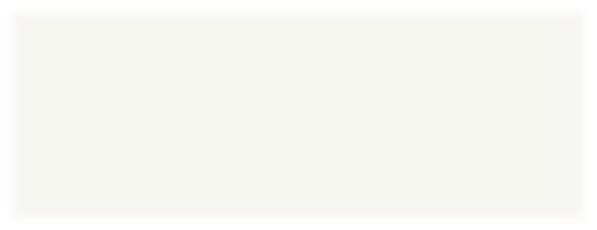
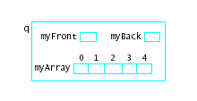
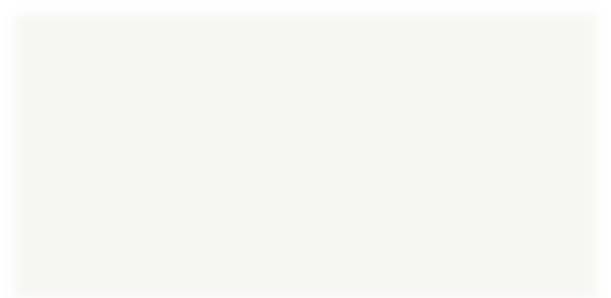
Designing and Building a Queue Class Array-Based
Consider an array in which to store a queue
Note additional variables needed
– myFront, myBack
Picture a queue object like this

Slide 15
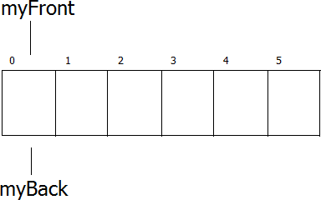
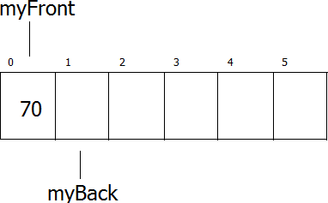
Queue Operation
Empty Queue
Enqueue(70)

Slide 16
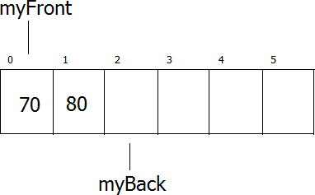
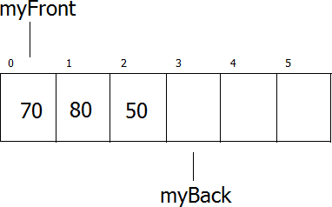
Queue Operation
Enqueue(80)
Enqueue(50)

Slide 17
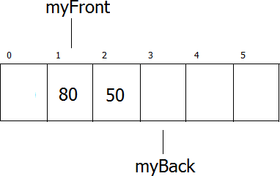
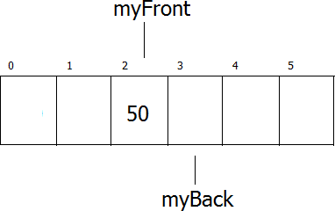
Queue Operation
Dequeue()
Dequeue()

Slide 18
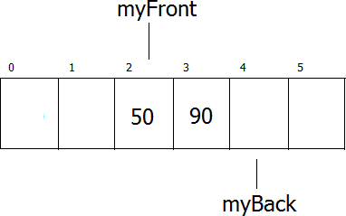
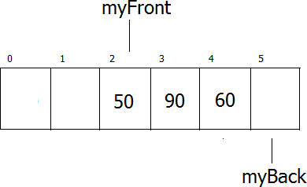
Queue Operation
Enqueue(90)
Enqueue(60)

Slide 19
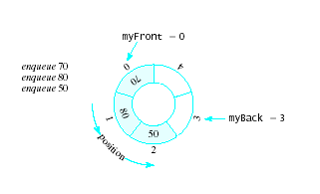
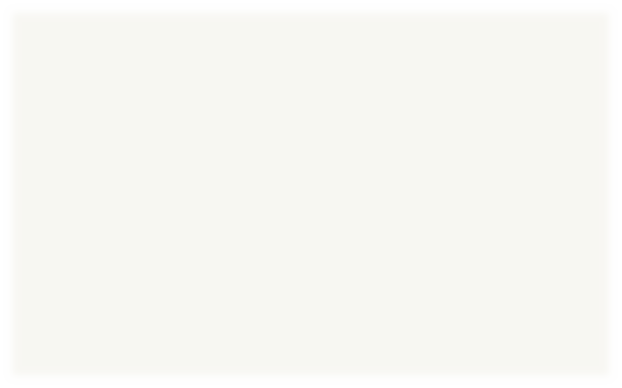
Circular Queue
Problems
We quickly "walk off the end" of the array
Possible solutions
Shift array elements
Use a circular queue
Note that both empty and full queue
gives myBack == myFront

Slide 20
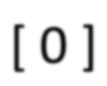
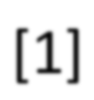
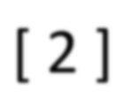
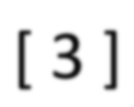
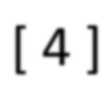
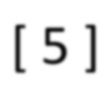
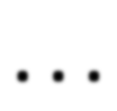
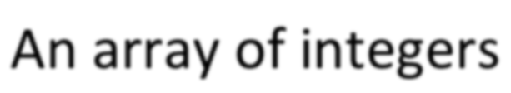
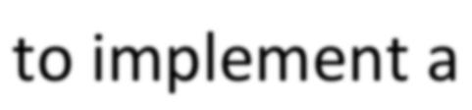
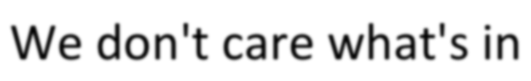
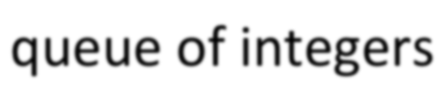
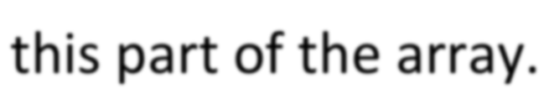
Array Implementation
A queue can be implemented with an array, as shown here. For example, this queue contains the integers 4 (at the front), 8 and 6 (at the rear).
[ 0 ] [1] [ 2 ] [ 3 ] [ 4 ] [ 5 ] . . .
4 | 8 | 6
An array of integers to implement a queue of integers
We don't care what's in this part of the array.

Slide 21
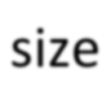
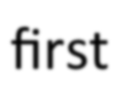
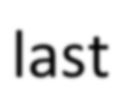
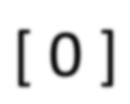
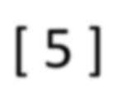
Array Implementation
The easiest implementation also keeps track of the number of items in the queue and the index of the first element (at the front of the queue), the last element (at the rear).
3
size
0
first
2
last
[ 0 ] [1] [ 2 ] [ 3 ] [ 4 ] [ 5 ] . . .
4 | 8 | 6

Slide 22
A Dequeue Operation
When an element leaves the queue, size is decremented, and first changes, too.
2
size
1
first
2
last
[ 0 ] [1] [ 2 ] [ 3 ] [ 4 ] [ 5 ] . . .
4 | 8 | 6

Slide 23
An Enqueue Operation
When an element enters the queue, size is incremented, and last changes, too.
3
size
1
first
3
last
[ 0 ] [1] [ 2 ] [ 3 ] [ 4 ] [ 5 ] . . .
8
6
2

Slide 24
At the End of the Array
There is special behavior at the end of the array. For example, suppose we want to add a new element to this queue, where the last index is [5]:
3
size
3
first
5
last
[ 0 ] [1] [ 2 ] [ 3 ] [ 4 ] [ 5 ]
 |  |  | 2 | 6 | 1

Slide 25
At the End of the Array
The new element goes at the front of the array (if that spot isn’t already used):
4
size
3
first
0
last
[ 0 ] [1] [ 2 ] [ 3 ] [ 4 ] [ 5 ]
4 |  |  | 2 | 6 | 1

Slide 26
Array Implementation
Easy to implement
But it has a limited capacity with a fixed array
Or you must use a dynamic array for an unbounded capacity
Special behavior is needed when the rear reaches the end of the array.
[ 0 ] [1] [ 2 ] [ 3 ] [ 4 ] [ 5 ] . . .
3
size
0
first
2
last
4 | 8 | 6

Slide 27
Linked List Implementation
A queue can also be implemented with a linked list with both a
head and a tail pointer.
13
15
10
7
null
head_ptr
tail_ptr

Slide 28
Linked List Implementation
Which end do you think is the front of the queue? Why?
13
15
10
7
null
head_ptr
tail_ptr

Slide 29
Linked List Implementation
The head_ptr points to the front of the list.
Because it is harder to remove items from the tail of the list.
Front
13
15
10
7
null
head_ptr
Rear
tail_ptr

Slide 30
Abstract Data Type
Abstract Data Type as a design tool
Concerns only on the important concept or model
No concern on implementation details.
Stack & Queue is an example of ADT
An array is not ADT.

Slide 31
What is the diﬀerence?
Stack & Queue vs. Array
– Arrays are data storage structures while stacks and queues are specialized DS and used as programmer’s tools.
Stack – a container that allows push and pop
Queue -­‐ a container that allows enqueue and dequeue
No concern on implementation details.
In an array any item can be accessed, while in these data structures access is restricted.
They are more abstract than arrays.

